Slide 1
Discussion Unit: DSE Analytics, Lambda Architecture
Discuss Lamdba architecture as it relates to DSE, DSE Analytics
Notes:
The goal of this Discussion Unit is to discuss architectures, including lambda architecture.

Slide 2
Discussion Lab:
Architectures of years past and present-
Matching pairs – Match the attributes on the right with the areas on the left
Notes:
On the next page we enter a Discussion Lab.

Slide 3



DSE Analytics: Architectures of years past
Data Mart
Data Warehouse
Enterprise Data Warehouse/Layer
Data Lake
Excel Spreadsheet
Notes:
Discuss the impact of past data related architectures-
Sources:
https://knowyourmeme.com/memes/nerd-on-computer
(Simon Sined)
Reference Urls,
https://www.sisense.com/blog/demystifying-data-warehouses-data-lakes-data-marts/
https://www.blue-granite.com/blog/bid/402596/top-five-differences-between-data-lakes-and-data-warehouses

Slide 4
End of Discussion Lab:
Notes:
End of Discussion Lab-

Slide 5
Wikipedia: Lambda Architecture
Lambda architecture is a data-processing architecture designed to handle massive quantities of data by taking advantage of both batch and stream-processing methods. This approach to architecture attempts to balance latency, throughput, and fault-tolerance by using batch processing to provide comprehensive and accurate views of batch data, while simultaneously using real-time stream processing to provide views of online data. The two view outputs may be joined before presentation. The rise of lambda architecture is correlated with the growth of big data, real-time analytics, and the drive to mitigate the latencies of map-reduce.
Lambda architecture depends on a data model with an append-only, immutable data source that serves as a system of record.
It is intended for ingesting and processing times tamped events that are appended to existing events rather than overwriting them. State is determined from the natural time-based ordering of the data.
Source: https://en.wikipedia.org/wiki/Lambda_architecture
Notes:
Lambda architecture definition from Wikipedia.com

Slide 6
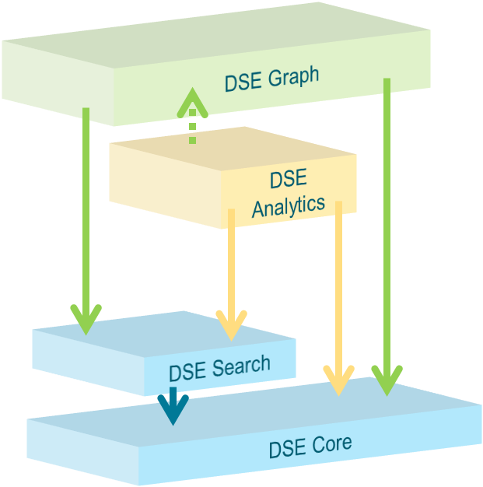

Review: The 4 Primary Functional Areas to DSE
All 4 primary functional areas provide query processing
DSE Analytics
-- Parallel Query Processing
Horizontal scaling
High Speed
-- Batch, Streaming, Iterative, Interactive
The Why
Query processing
Index and query processing
Notes:
The four primary functional areas to DSE are listed in the graphic above: DSE Core (Core), DSE Search (Search), DSE Analytics (Analytics), DSE Graph (Graph).
Core is always on; it is impossible to operate any node within a DSE cluster without Core.
The remaining 3 primary functional areas are either on or not on (on/booted/available, or not). If Search and a Search index is available (and necessary), Analytics or Graph may use said index. Generally, if Analytics or Graph would benefit from a Search index, and none is available, the Analytics or Graph routine will still function, albeit more slowly.
While Core is always on, (Search, Analytics and/or Graph) must be on/booted/available on a data center wide basis. That is to say: you should not boot (Search, Analytics, Graph) on a subset of nodes to a data center.
--
We discuss the capabilities of DSE Analytics on the pages that follow.

Slide 7
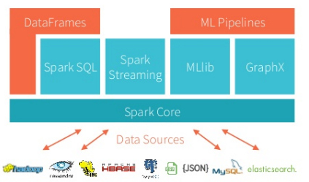
Review: DSE Analytics, 5 Major Functional Areas
Image Source: DataBricks.com
Notes:
There is the main spark engine (core), and on top of it fits Spark’s 4 main modules: 4 + 1 == 5
(Some diagrams will also highlight a 5'th main module, Spark/R.)
Spark SQL and Data Frames
Gives SQL like access to data, many ANSI standards implemented
Can access Hive, Avro, Parquet, ORC, JSON, and JDBC
Allows you to join across the various data sources
No ETL needed to process data
Spark Streaming
Often used with Kafka
Native APIs for Java, Scala and Python
MLlib (machine learning)
Machine Learning and all the goodness
that implies
GraphX with GraphFrames
DSE graph ties into GraphFrames
May optimize certain type of DSE Graph
Jobs
Reference Urls,
https://mapr.com/blog/5-minute-guide-understanding-significance-apache-spark/

Slide 8
DSE Analytics: Lambda Architecture
DSE Analytics is part of a Lambda Architecture
The idea and original term Lambda Architecture was first introduced in Book https://www.manning.com/books/big-data , by Nathan Marz (2012)
Lambda has become an overloaded phrase; buzzword and marking material without necessarily tying back to the original intent
True Lambda architectural design in your enterprise applications is considered a key part of an enterprise ready system, making the idea of saying your design is part of Lambda appealing
Lambda architecture is a data-processing architecture designed to handle massive quantities of data by taking advantage of both batch- and stream-processing methods
Notes:
Reference Urls,
https://en.wikipedia.org/wiki/Lambda_architecture
https://dzone.com/articles/nathan-marzs-lamda
http://www.databasetube.com/database/big-data-lambda-architecture/

Slide 9
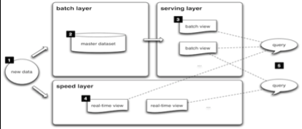
DSE Analytics: Lambda Architecture
The lambda architecture is an attempt to solve the problem of computing arbitrary functions on arbitrary data in real time
Notes:
The lambda architecture is an attempt to solve the problem of computing arbitrary functions on arbitrary data in real time.

Slide 10

DSE Analytics: Lambda Architecture
The promise of Lambda:
Analysis happens on streaming ingest allowing for time sensitive value to be captured
Batch layer re-calculates fast analytics and corrects accuracy
Serving layer accesses both layers and treats batch layer as authoritative for conflicts
Three layers:
Streaming/Speed
Batch
Serving
Notes:
The value proposition of a lambda architecture above-

Slide 11
DSE Analytics: Lambda Architecture
Ingest flow - double writes into queue and DSE
Ingest Flow
Write
Elastic Application Tier
Event Sourcing
Publish
Queue / Message Bus
Notes:
Newly arrived/observed data is written via dual writes; streaming, and also history

Slide 12
DSE Analytics: Lambda Architecture
Batch Layer - DSE batch aggregations
Ingest Flow
Write
Elastic application Tier
Batch Layer
Notes:
DSE Analytics provides the: batch layer, analytics tier, machine learning, data cleansing and enrichment, other

Slide 13
DSE Analytics: Lambda Architecture
Server Layer - Batch wins for accuracy
Serving Layer
Elastic application Tier
Read
Read
Ingest Flow
Write
Elastic application Tier
Event Sourcing + Batch Layer
Speed Layer
Publish
Streaming Ingest
Queue / Message Bus
Notes:
Eventually, streaming data arrives at the DSE layer, with DSE being the system of record.

Slide 14
DSE Analytics: Lambda Architecture
Decompose the problem into three layers:
Batch layer
-- Stores immutable Master Data Set
-- Computes Arbitrary Views - functions on data
Serving layer
-- Random Access to Batch Views
-- Updated by batch layer
Streaming/speed layer
-- Compensates for high latency of update to serving layer
-- Fast incremental Algorithms
Batch layer eventually overrides speed layer
-- Batch layer looks at all data
-- Streaming/speed layer for incremental updates
Notes:
Review-

Slide 15

DSE Analytics: Lambda Architecture, How DSE fits
HDFS
Hive and SparkSQL
BI Tools
Flume or Spark Streaming
SparkR
MapReduce
Spark
Events
Kafka
Analytic
Results
Data Science Workflows
CQL Writes in Real Time
Direct Read from
CQL Rollup Tables
Sensors
Realtime
Dashboards
Spark Streaming
Transactions
Replication
CQL Reads
Runs in Analytics DC
Replication
Applications
Analytics
Search
Solr Reads (CQL & HTTP)
Spark
Rollups and
Data Science
Notes:
DSE in the larger picture-

Slide 16
End of Unit:
Notes:
End of Discussion Unit-

